Slide 1

QR CODE GENERATION IN PYTHON
-by CSI SPM ML 2210

Slide 2
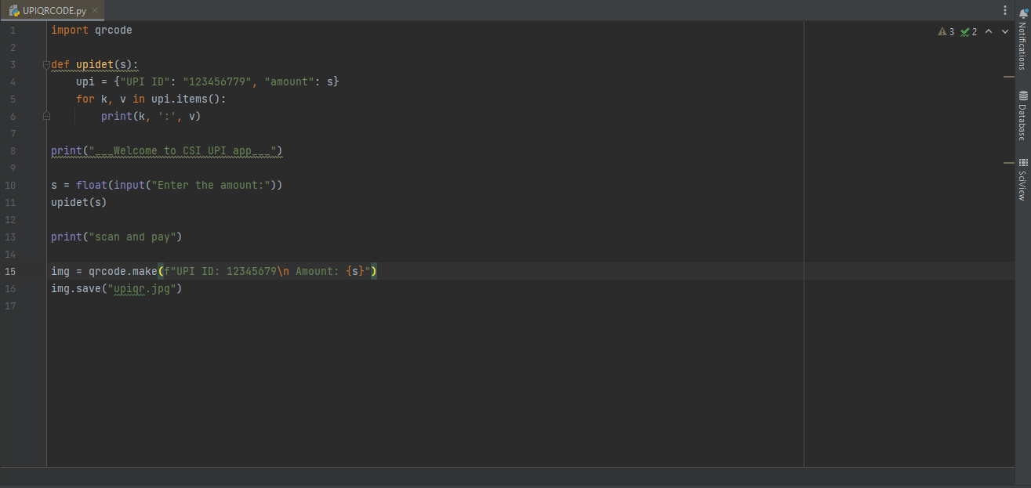
Source code:

Slide 3
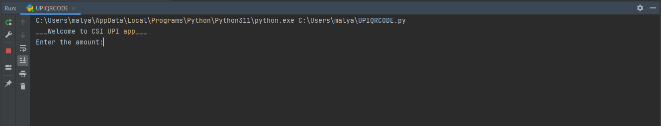
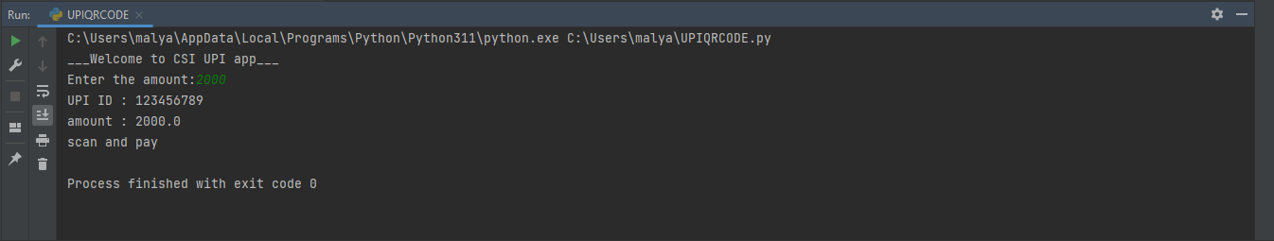

Slide 4
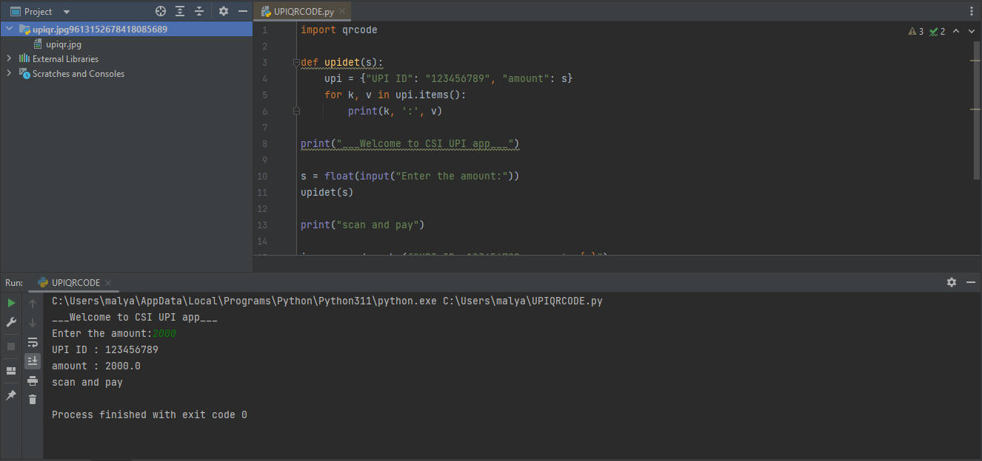
The generated QR CODE is saved as image in JPG format here

Slide 5
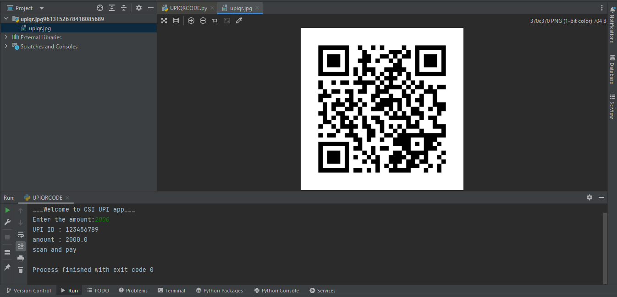
QR CODE generated is scanned for getting transactions details

Slide 6
We can further modify and generate the QR CODE for further transactions.
‘qrcode’ library is used to generate this QR CODE program.
Note:This program is runned in “PYCHARM” compiler.

Slide 7
THANK YOU

